Slide 1

Marketing Insight Report
HNG Data Analysis Stage Zero

Slide 2
RELEVANT LINKS FOR THE TASK
Jupyter Notebook
HNG Tech Internship
HNG Tech Data Analysis

Slide 3
CONTENT LAYOUT
INTRODUCTION
OBSERVATION
CONCLUSION
INTRODUCTION
CONCLUSION
OBSERVATION

Slide 4
INTRODUCTION
Retail Sales Data (Marketing-Focused)
The above named is the chosen dataset for this task.
This shape of the dataset is 9994 rows and 13 columns
The data types comprises of three float64, two int64, and 8 object
The statistical view of the numerical columns (float and int) are given in the below table:
 | Postal Code | Sales | Quantity | Discount | Profit
count | 9994.000000 | 9994.000000 | 9994.000000 | 9994.000000 | 9994.000000
mean | 55190.379428 | 229.858001 | 3.789574 | 0.156203 | 28.656896
std | 32063.693350 | 623.245101 | 2.225110 | 0.206452 | 234.260108
min | 1040.000000 | 0.444000 | 1.000000 | 0.000000 | -6599.978000
25% | 23223.000000 | 17.280000 | 2.000000 | 0.000000 | 1.728750
50% | 56430.500000 | 54.490000 | 3.000000 | 0.200000 | 8.666500
75% | 90008.000000 | 209.940000 | 5.000000 | 0.200000 | 29.364000
max | 99301.000000 | 22638.480000 | 14.000000 | 0.800000 | 8399.976000

Slide 5
INTRODUCTION CONTD
The object columns cardinality ranges from high cardinality of 531 in city to low cardinality of 1 in country:
City 531
State 49
Category 17
Region 4
Ship Mode 4
Segment 3
Category 3
Country 1

Slide 6
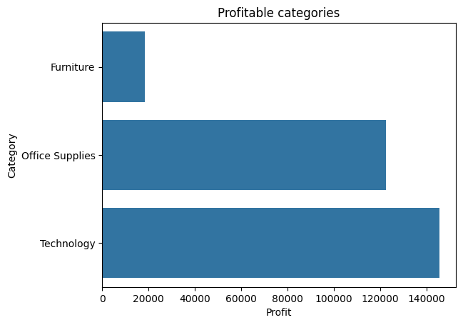
2. OBSERVATIONS - A
The total sum of profit and loss in the dataset is 286397.0217
Technology product category has over 48% contribution to the profit of the retail business, closely followed by office supplies
The sum total of the profit and loss of Furniture is less than 7%.

Slide 7
2. OBSERVATIONS – A (CONTD)
CATEGORY | SALES FREQUENCY
Office Supplies | 6026
Furniture | 2121
Technology | 1847
In a dataset of 9994 sales transaction, Technology with less than 19% of the transactions have the highest overall percentage profit contribution.

Slide 8
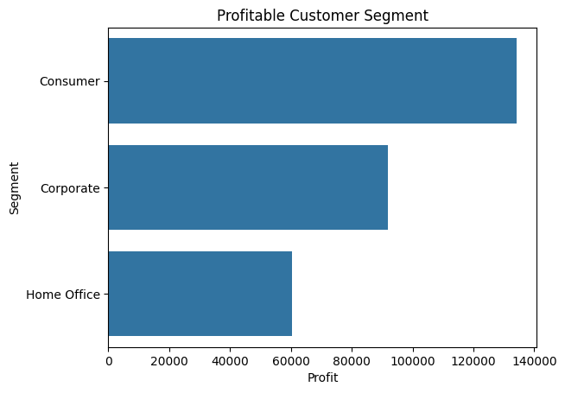
2. OBSERVATIONS - B
Segment | FREQUENCY
Consumer | 5191
Corporate | 3020
Home Office | 1783

Slide 9
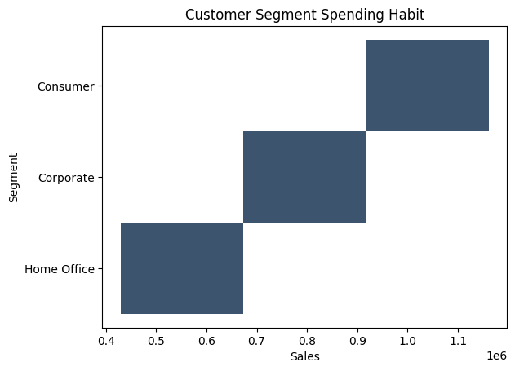
2. OBSERVATIONS – B(contd)
The total sum of sales in the period is 2297200.8603000003
Consumer out of the custom Spending Habit.
Consumers are also the loyal customers with the highest repeated transactions count of 5191
Suffix to say that, it is also observed that more than half of the retail firm profit is made from the consumer segment sales.

Slide 10
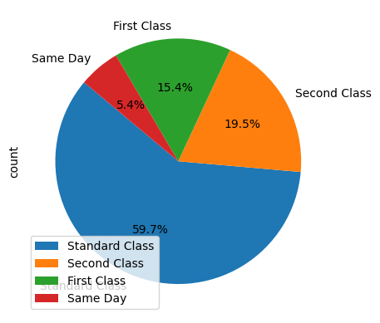
2. OBSERVATIONS – C – Ship Mode
Standard class has the highest frequency count. Which shows preference of the customers.for that ship mode

Slide 11
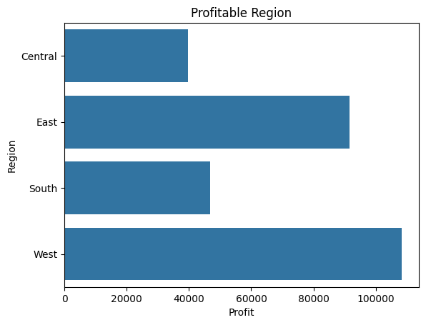
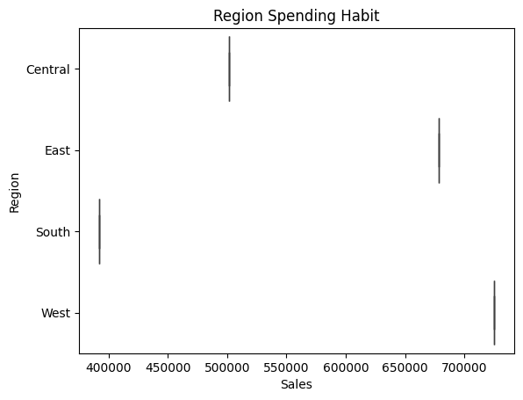
2. OBSERVATIONS - D
West Region spends more and more profit stems out of this region.
Central region spends more than south region
However, More profit are made from the south region than the central region

Slide 12
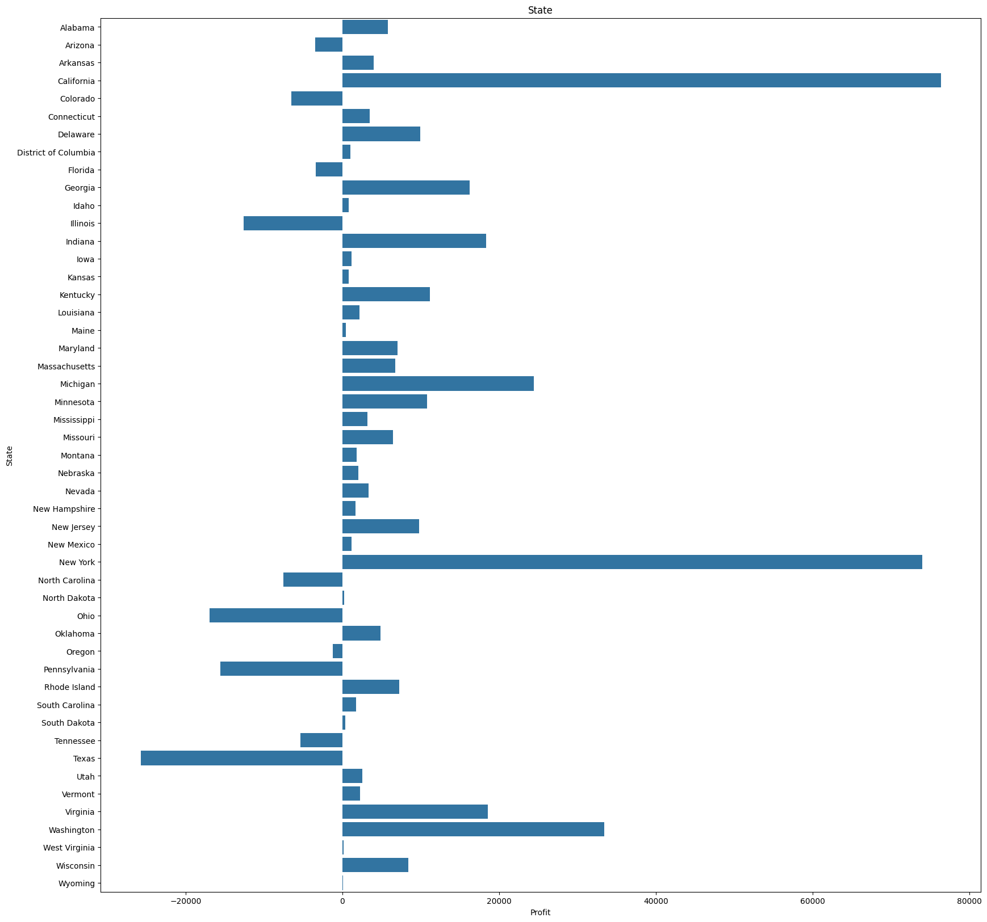
2. OBSERVATIONS – E - State
The sum total of the profit column in state resulted in loss in some state like Texas, Pennsylvania, Ohio, and many more as seen in the chart
Sales made in California, New York contribution to most of the profit.

Slide 13
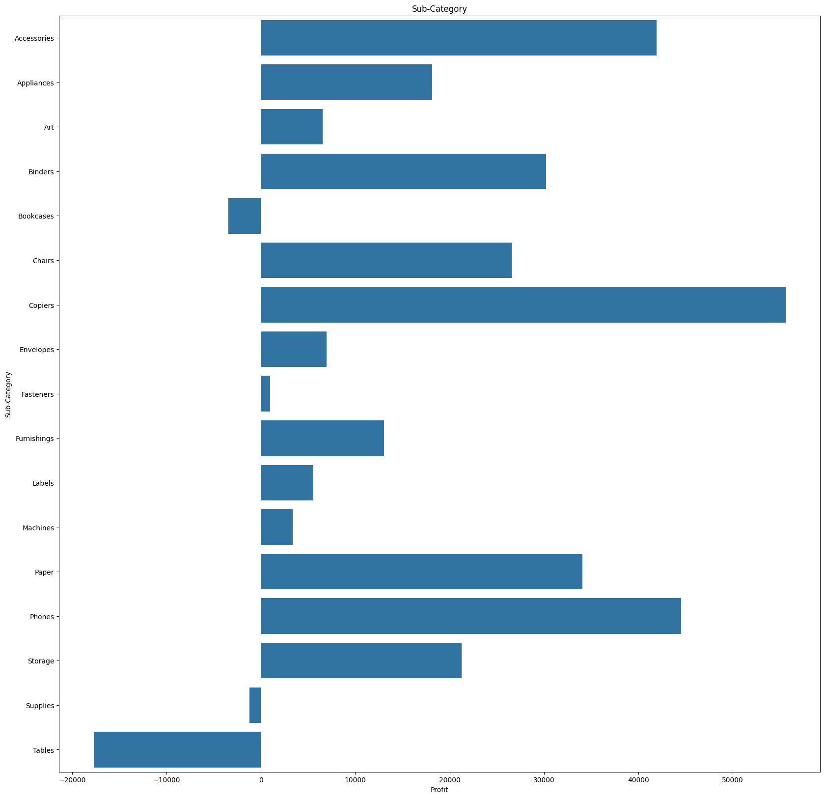
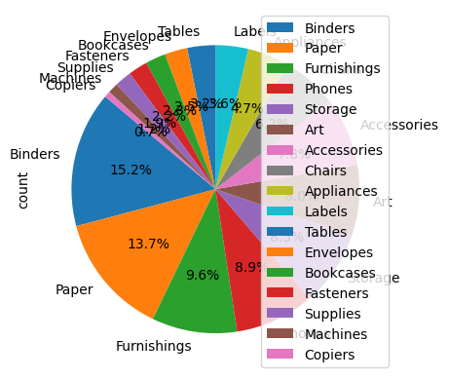
2. OBSERVATIONS – E – SUB-CATEGORY
The sum total of the profit column in sub category resulted in loss in some sub category like bookcases, supplies, and tables.
Among the profitable sub category are copiers, Accessories, phones among many other.
The frequency of the subcategory in the pie chart has binders as the highest purchase product

Slide 14
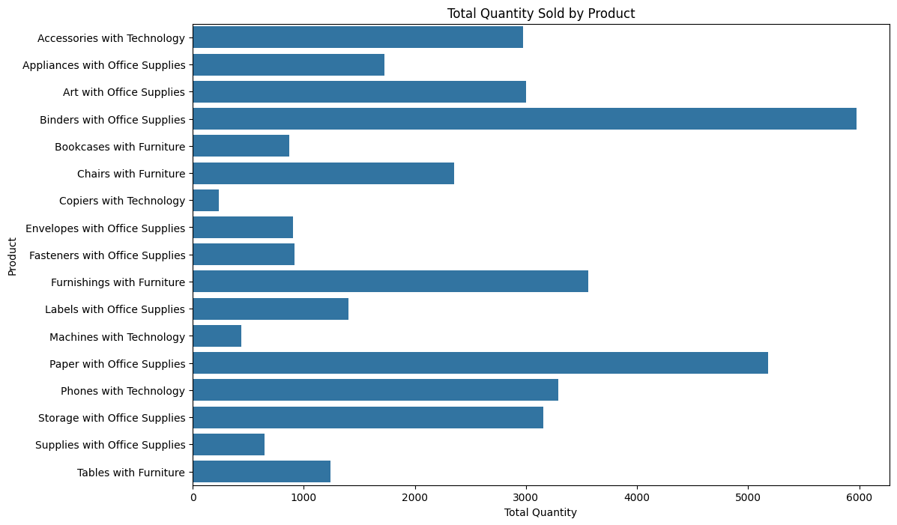
3. CONCLUSION – A – TOP-SELLING PRODUCT

Slide 15
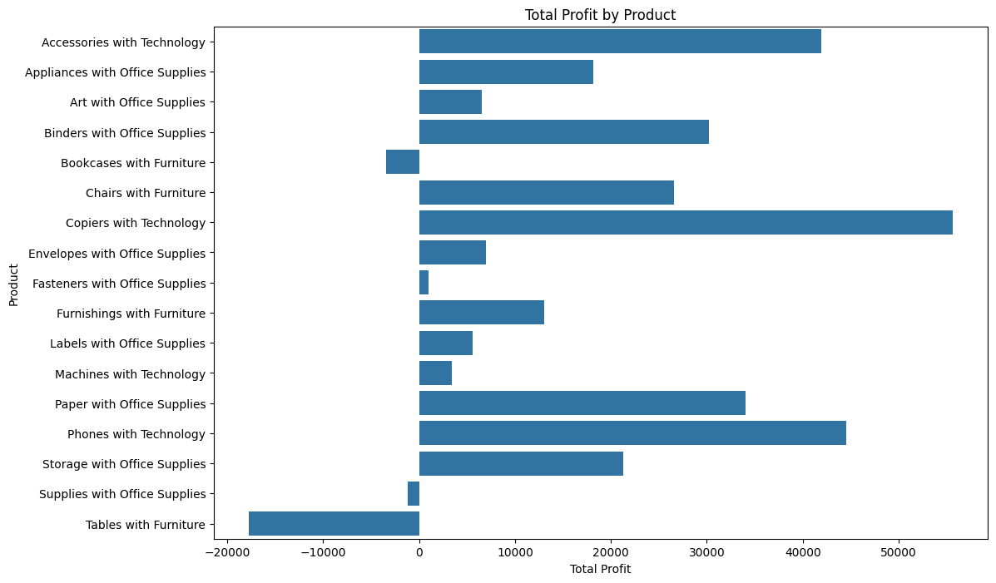
3. CONCLUSION – A – TOP-SELLING PRODUCT (CONTD)
Binders, paper, and storage with office supplies is the top selling products in respect to the selling amount and frequency.
The opposite is the case in terms of profit, where we see low sales price product such as copiers with Technology has the highest profitable products
with the above and observation A, Marketing insights should be carried on Technology category, then are more profitable and increasing the frequency could boast profit for the firm.

Slide 16
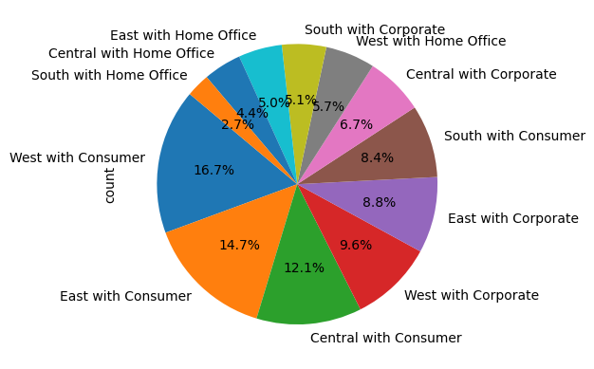
3. CONCLUSION – B– USER TRENDS
According to observation B; D, E. Marketing Insights should be focused on:
Consumer in all the four Regions, then Corporate in West and East Corporate.
New york and california state.

Slide 17
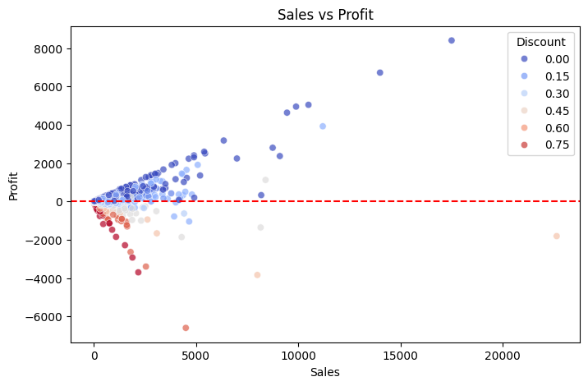
3. CONCLUSION – C – SELLING PRICE
In this scatterplot, the higher the selling price the higher the profit, and vice versa.
However, High selling price are less dense, thus, the company should look into marketing product with high selling price for better profits.
Discount was used as hue in this this scatterplot. With high discount colored red and no discount colored blue.
the higher the discount the lower the profit, resulting in high loss for high discount. Thus making discount not an important factor in marketing

